Slide 1


Covid - 19 Case study
https://www.kaggle.com/
Presented By:- Mohit Bokade
October 2021

Slide 2
Tableau PROJECT
Segment Data Source: https://www.kaggle.com/arashnic/covid19-case-surveillance-public-use-dataset
This project is based on Covid – 19 Cases, as per the data set ,we analyses how much virus spread all over the world
This data set contain 2 Lakh row and 6 column of Covid – 19 viral cases.
Data set contain data of 2019/ 2020 / 2021 hit record according to segment followed by their specification
FROM THIS DATASET ,THE FIELDS WHICH ARE USED AS FOLLOWS –
Observation Date , Province/State , Country/Region , Last Update , Confirmed case, Deaths case, Recovered cases.

Slide 3
PROBLEM STATEMENT
What are total number of confirmed cases in different nations?
What are the total number of recovered cases in different nations?
Find the highest death rates in international level.
What are the total number of confirmed cases in India ?
What are the total number of recovered cases in India ?
Can we forecast trend - line for covid - 19?
Can we group Indian states and find covid - 19 hits?
Can we find the variation in COVID - 19 cases around the world ?

Slide 4
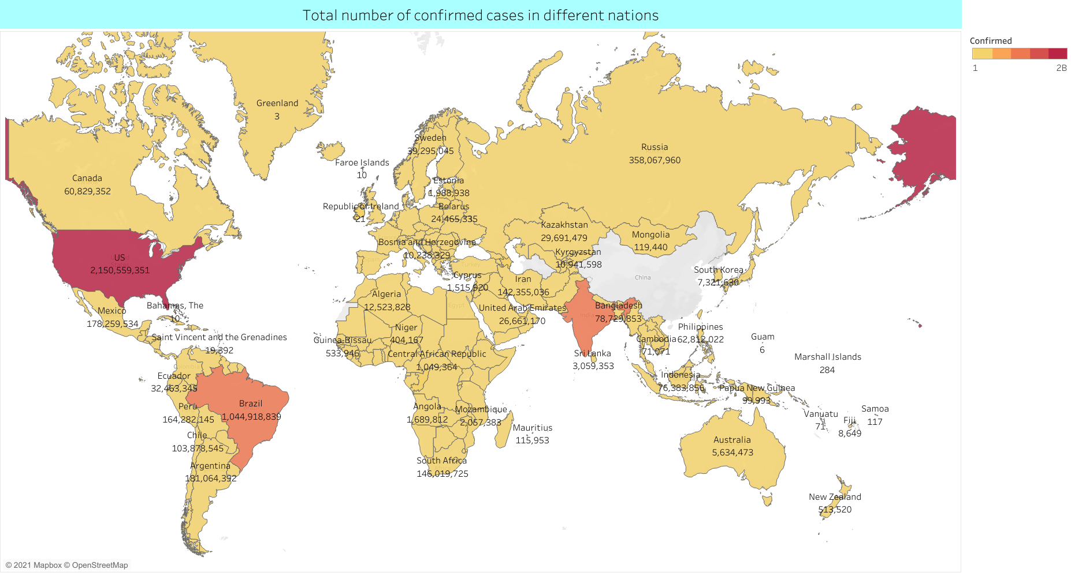
What are total number of confirmed cases in different nations?

Slide 5
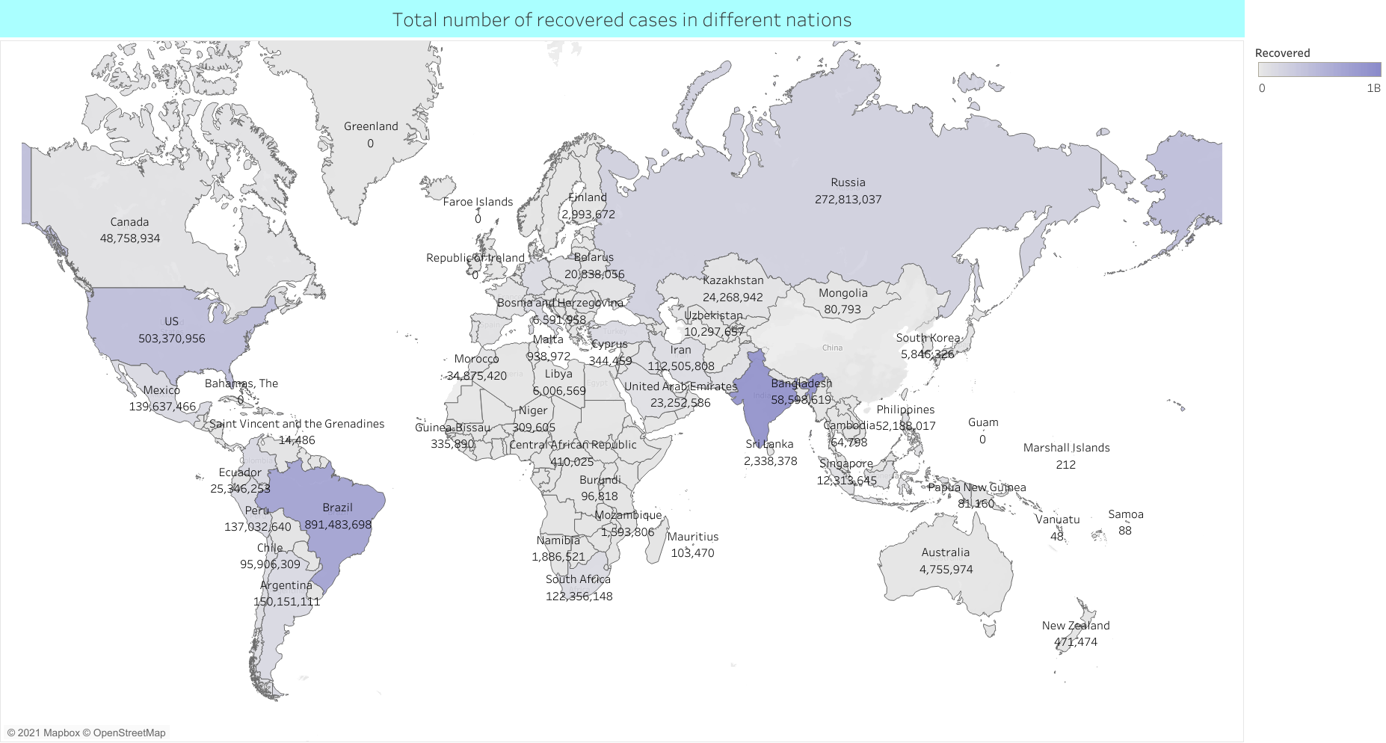
What are the total number of recovered cases in different nations?

Slide 6
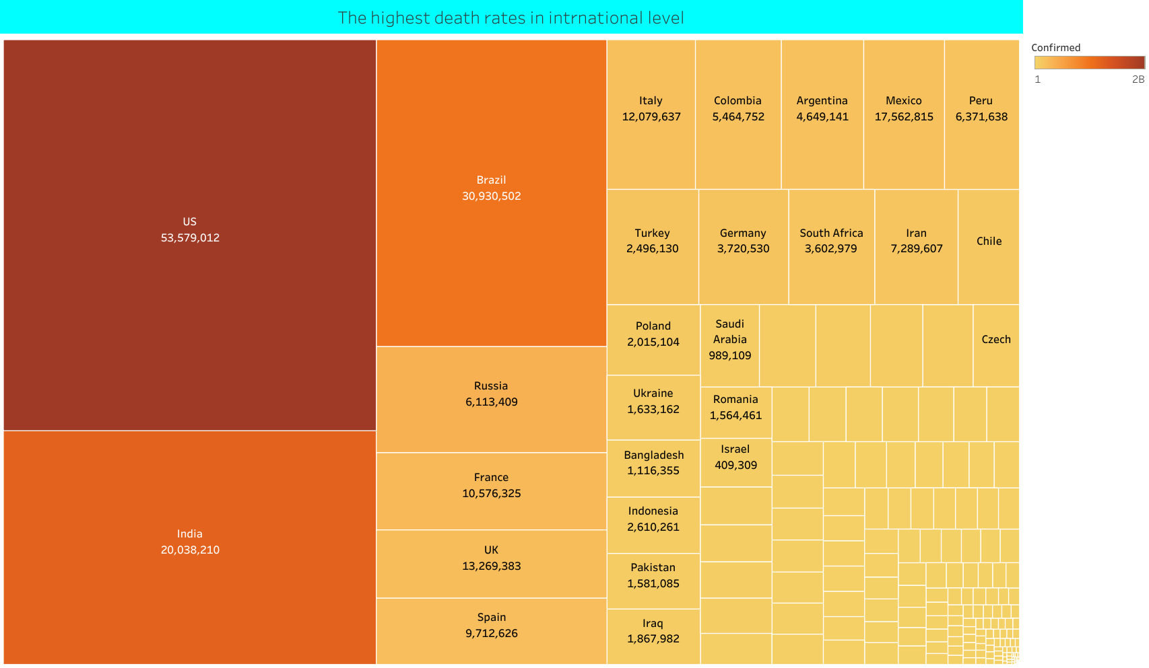
Find the highest death rates in international level.

Slide 7
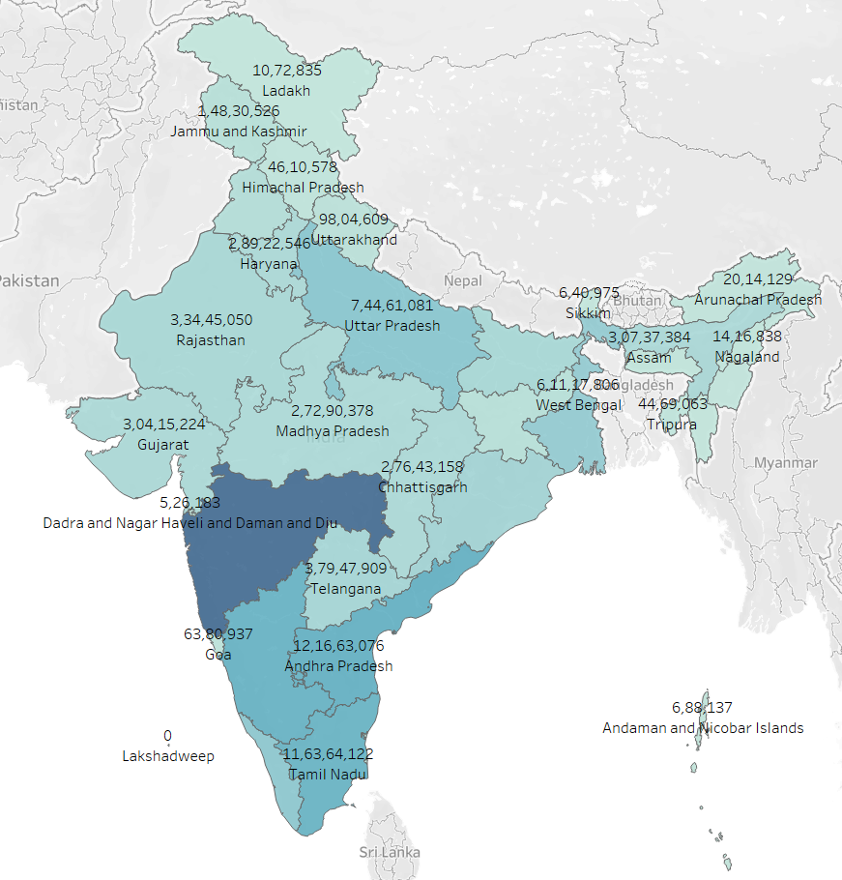
What are the total number of confirmed cases in India ?

Slide 8
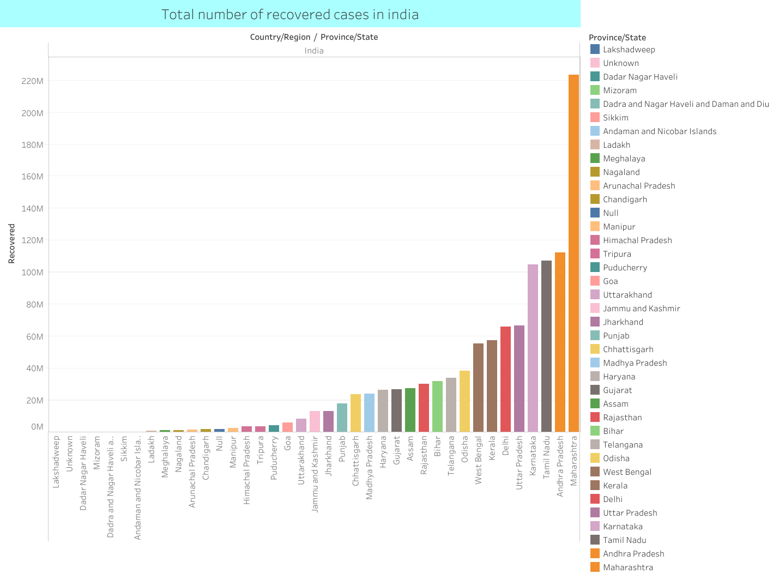

What are the total number of recovered cases in India ?

Slide 9
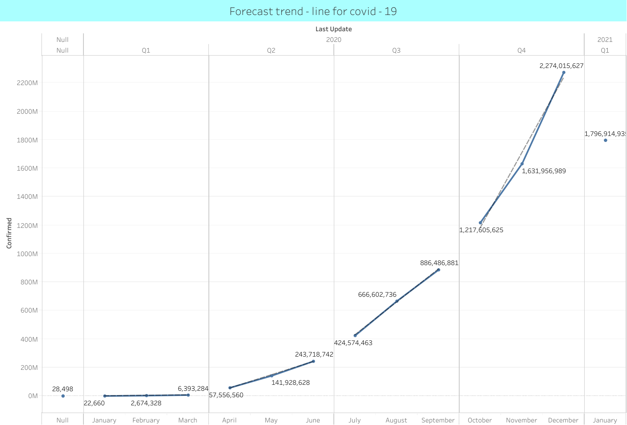
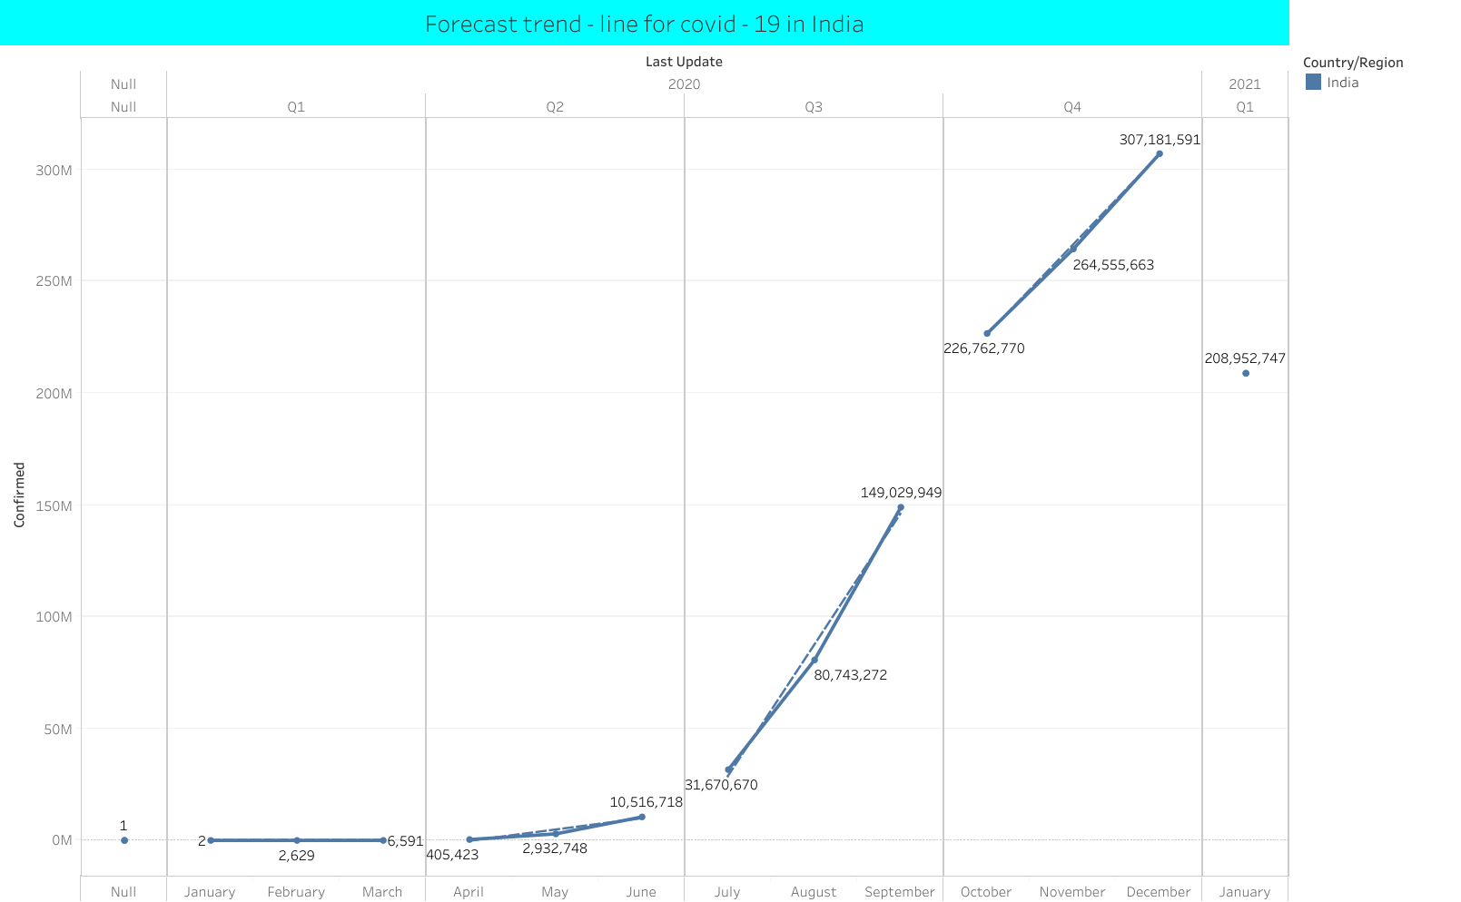
Forecast trend - line for covid - 19?
Group Indian states and find covid - 19 hits?

Slide 10
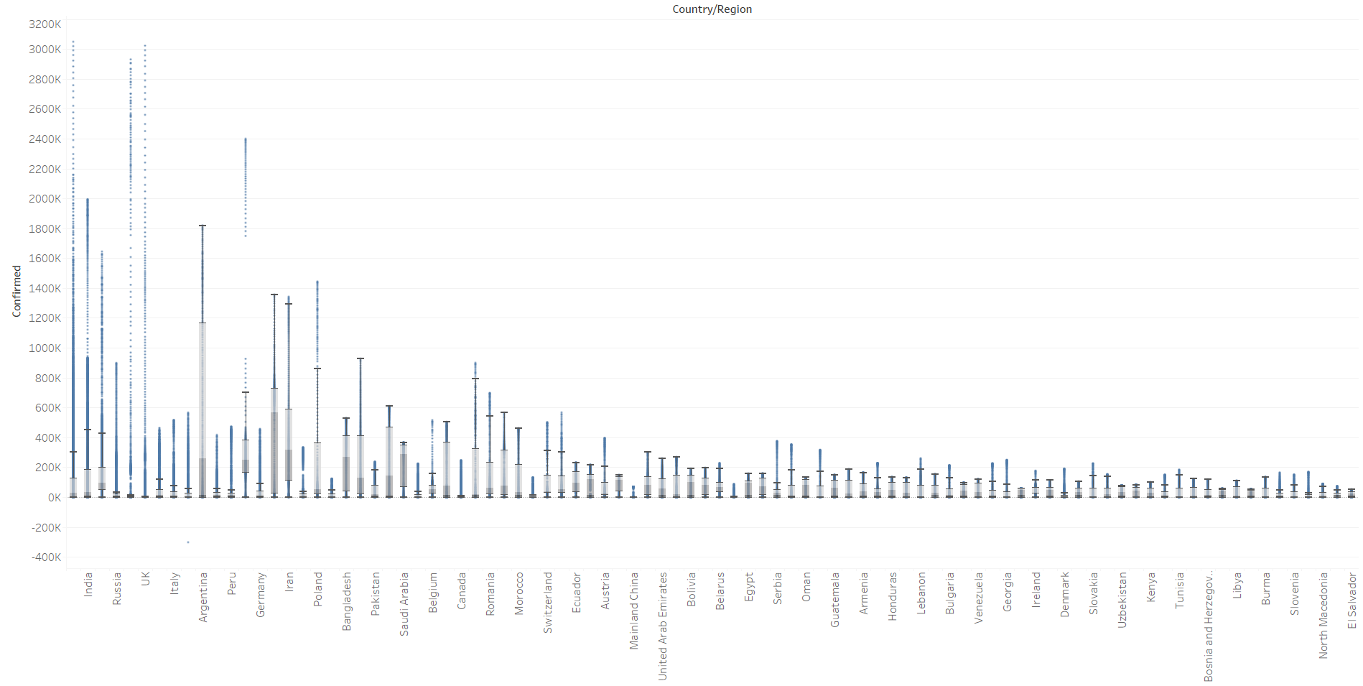
Variation in COVID - 19 cases around the world ?

Slide 11
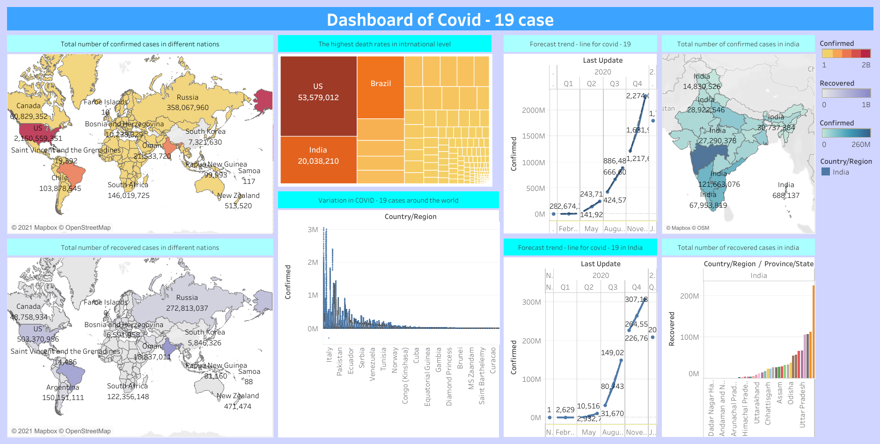

Slide 12
CONCLUSION: -
FROM THE DATA SET, IT IS EVIDENT THAT US HAS THE HIGHEST CONFIRMED CASES
AND INDIA HAS THE HIGHEST RECOVER CASES WE CAN SAY INDIAN PEOPLE HAVE GOOD IMMUNITY SYSTEM OR GOOD TO PREPAIR FOR THE COVID – 19
BUT UNFORTUNATLY WE ANALYS THAT IN US HAS HIGHEST DEATH RATES THAT IS 5,35,79,012
AND WE FROM TREND LINE , WE SEE THAT COVID – 19 CASE IN 2021 WERE GO DOWN.
PEAOPLE JUST NEED TO HOME CORAN TINE SO THAT CASE WILL BECOME ZERO
Tableau Project : -
https://public.tableau.com/views/Covid-19CaseStudy_16334197289690/ConfirmedCasesINTL?:language=en-US&publish=yes&:display_count=n&:origin=viz_share_link
Project Presentation Video:
https://drive.google.com/file/d/1wVy-dHIt0OVgONxBXVrKUq0boe8lNwch/view?usp=sharing
Thank You!!

